Slide 1
My family, Families big and small
Basic 02 Unit 3b

Slide 2
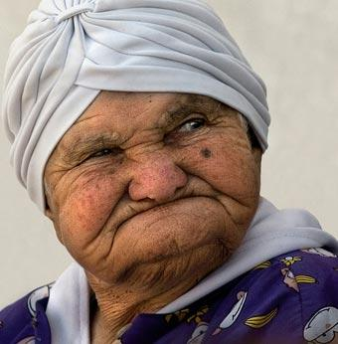
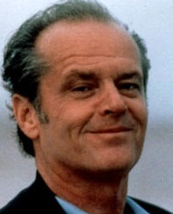
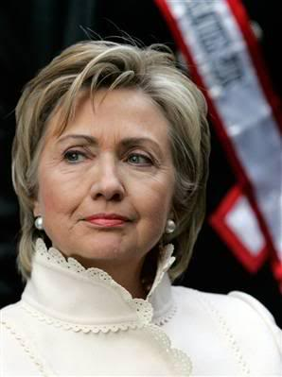
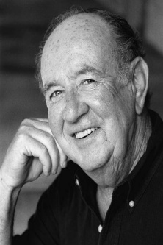
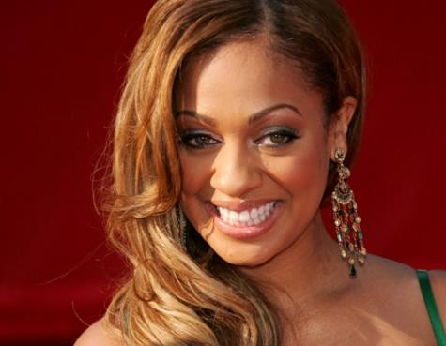
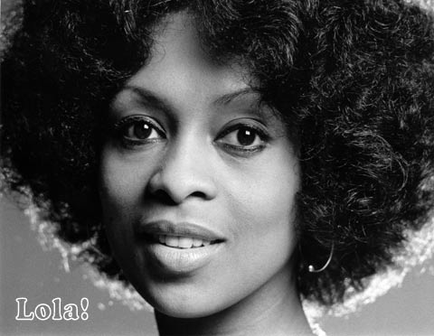
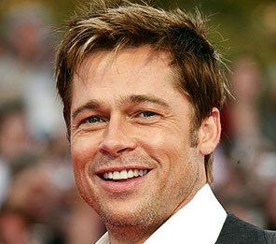
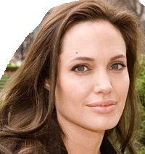
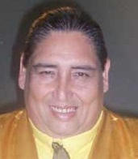
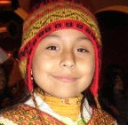

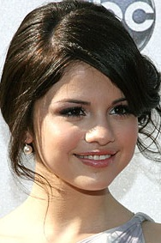
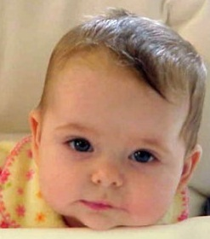
Justin’s Family Tree
Linda
Jack
Hillary
Hilario
Lala
Lola
Brad
Angelina
Tongo
Luciano
Justin
Selena
Adriana

Slide 3
Brad’s Family Tree
Linda and Jack are married.
Linda is Jack’s wife.
Jack is Linda´s husband.
Lala, Lola and Brad are Linda and Jack´s children.
Lala is Linda´s daughter.
Lola is Linda´s daughter.
Brad is Linda´s son.
Lala is a single mother.
Luciano is Lala´s son.
Luciano is Linda´s grandson.
Luciano is Jack´s grandson.
Jack and Linda are Luciano´s grandparents.
Lola is Lala´s sister.
Lola is Brad´s sister.
Brad is Lola´s brother.
Brad is Luciano´s uncle.
Lola is Luciano´s aunt.
Luciano is Lola´s newphew.
Jack is Luciano´s grandfather
Linda
Jack
Lala
Lola
Brad
Luciano

Slide 4
Angelina’s Family Tree
Hillary and Hilario are married.
Hillary is Hilario´s wife.
Hilario is Hillary´s husband.
Hillary and Hilario have one daughter.
Angelina is Hillary and Hilario´s daughter.
Hillary and Hilario are Angelina´s parents.
Angelina is a single child. She doesn´t have any brothers or sisters.
Hillary
Hilario
Angelina

Slide 5
Justin’s Family Tree
Linda
Jack
Hillary
Hilario
Angelina and Brad are married.
They have two children.
Justin and Selena are Brad and Angelina´s children.
Justin is Selena´s brother.
Hillary, Hilario, Linda and Jack are Justin and Selena´s grandparents.
Justin is Jack´s grandson.
Selena is Jack´s granddaughter.
Lola is Justin´s aunt.
Justin is Lola´s nephew.
Selena is Lola´s niece.
Lola is Angelina´s sister-in-law
Hillary is Brad´s mother-in-law
Jack is Angelina´s father-in-law
Lola
Brad
Angelina
Justin
Selena

